Slide 1
Chapter – 11 System test design

Slide 2
Outline of the Chapter
Test Design Factors
Requirement Identification
Test Objective Identification
Modeling a Test Design Process
Modeling Test Results
Test Design Preparedness Metrics
Test Case Design Effectiveness

Slide 3
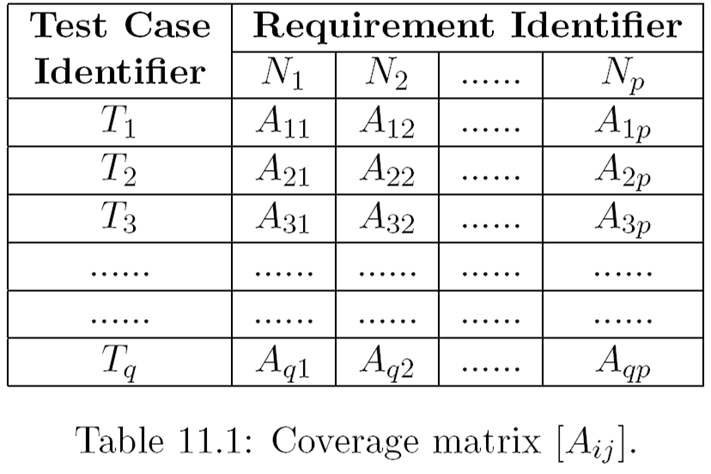
Test Design Factors
The following factors must be taken into consideration during the design of system tests
Coverage metrics
Effectiveness
Productivity
Validation
Maintenance
User skills
A coverage matrix is used to trace the requirements from the client to the tests that are needed to verify whether the requirements are fulfilled.

Slide 4
Requirement Identification
Statistical analysis conducted by Vinter reveals that out 1000 defects:
23.9 % requirement issues
24.3 % functionality
20.9% component structure
9.6 % data
4.3 % implementation
5.2 % integration
0.9 % architecture
6.9 % testing
4.3 % others

Slide 5
Requirement Identification
Requirements are a description of the needs or desire of users that a system is supposed to implement
Two major challenges in defining requirements:
Ensure that the right requirements are captured which is essential for meeting the expectations of the users
Ensure that requirements are communicated unambiguously to the developers and testers so that no surprise when the system is delivered
The requirements must be available in a centralized place so that all the stakeholders have the same interpretation of the requirements
A stakeholder is a person or an organization who influences a system’s behavior or who is impacted by the system

Slide 6
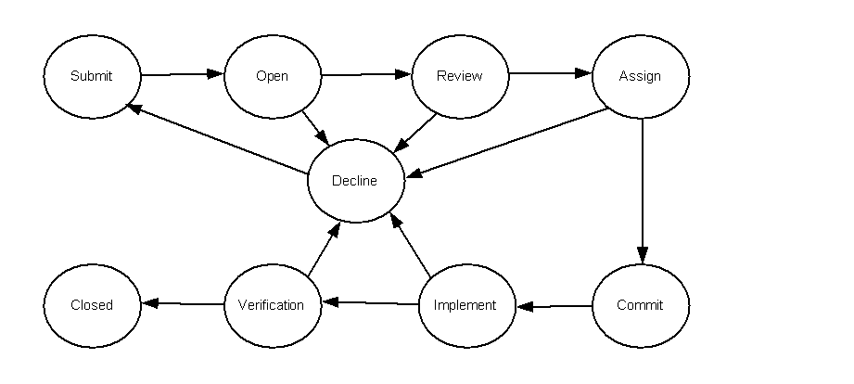
Requirement Identification
The state diagram of a simplified requirement life-cycle starting from Submit state to the Closed state is shown in the Figure.
At each of these states certain actions are taken by the owner, and the requirement is moved to the next state after the actions are completed
A requirement may be moved to Decline state from any of the following state: Open, Review, Assign, Implement, and Verification for several reasons
A marketing manager may decide that the implementation of a particular requirement may not generate revenue and may decline a requirement.
Figure 11.1: State transition diagram of a requirement

Slide 7
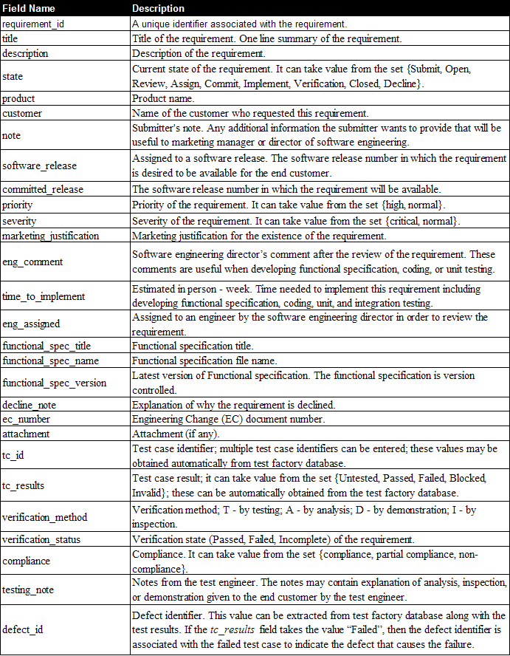
Requirement Identification
Table 11.1: Requirement schema field summary

Slide 8
Requirement Identification
Definition of requirements traceability:
The requirements traceability is the ability to describe and follow the life of a requirement, in both forward and backward direction, i.e., from its origins, through its development and specification, to its subsequent deployment and use, and through periods of ongoing refinement and iteration in any of these phases.

Slide 9
Traceability matrix
A traceability matrix allows one to find a two-way mapping between requirements and test cases as follows
From a requirement to a functional specification to specific tests which exercise the requirements
From each test case back to the requirement and functional specifications
A traceability matrix finds two applications:
To identify and track the functional coverage of a test
To identify which test cases must be exercised or updated when a system evolves

Slide 10
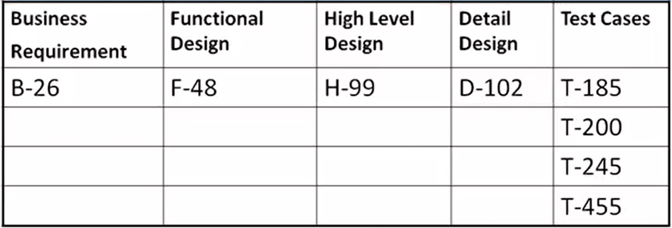
Traceability matrix

Slide 11
Difference between coverage and traceability matrix
Coverage metrics are concerned with the extent to which the device under test (DUT) is examined by a test suite that meets certain criteria. The criteria may be node testing, branch testing, or a feature identified from a requirement specification.
A traceability matrix allows one to find a mapping between the requirements and test cases both ways as follows:
• From a requirement to a functional specification to specific tests which exercise them.
• From each test case back to the requirement and functional specification.
A traceability matrix assists is identifying and tracking the functional coverage of a test suite. Without a traceability matrix it is difficult to determine the extent of requirement coverage achieved by a particular test suite.

Slide 12
Characteristics of Testable Requirements
One way to determine the requirement description is testable is as follows:
Take the requirement description “The system must perform X.”
Encapsulate the requirement description to create a test objective: “Verify that the system performs X correctly.”
Review this test objective and find out if it is possible to execute it assuming that the system and the test environment are available
If the answer to the above question is yes, then the requirement description is clear and detailed for testing purpose
Otherwise, more work needs to be done to revise or supplement the requirement description

Slide 13
Characteristics of Testable Requirements
The following items must be analyzed during the review of requirements:
Safety
Security
Completeness
Correctness
Consistency
Clarity
Relevance
Feasibility
Verifiable
Traceable

Slide 14
Characteristics of Testable Requirements
A functional specification provides
a precise description of the major functions the system must fulfill the requirements
explanation of the technological risks involved
external interfaces with other software modules
data flow such as flowcharts, transaction sequence diagrams, and finite-state machines describing the sequence of activities
fault handling, memory utilization and performance estimates
any engineering limitation

Slide 15
Characteristics of Testable Requirements
The following are the objectives that are kept in mind while reviewing a functional specification:
Achieving requirements
Correctness
Extensible
Comprehensive
Necessity
Implementable
Efficient
Simplicity
Consistency with existing components
Limitations

Slide 16
Test Objective Identification
The question “What do I test?” must be answered with another question: “What do I expect the system to do?”
The first step in identifying the test objective is to read, understand, and analyze the functional specification
It is essential to have a background familiarity with the subject area, the goals of the system, business processes, and system users, for a successful analysis
One must critically analyze requirements to extract the inferred requirements that are embedded in the requirements
An inferred requirement is one that a system is expected to support, but not explicitly stated
Inferred requirements need to be tested just like the explicitly stated requirements

Slide 17
Test Objective Identification
The test objectives are put together to form a test group or a subgroup after they have been identified
A set of (sub) groups of test cases are logically combined to form a larger group
A hierarchical structure of test groups as shown in Figure 11.2 is called a test suite
It is necessary to identify the test groups based on test categories, and refine the test groups into sets of test objectives
Individual test cases are created for each test objective within the subgroups
Test groups may be nested to an arbitrary depth
The test grouping may be used to aid system test planning and execution that are discussed in Chapters 12 and 13, respectively

Slide 18
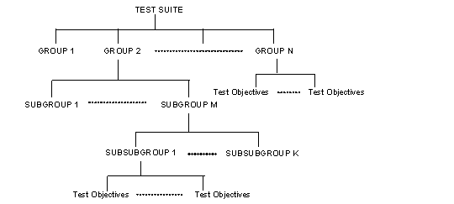
Test Objective Identification
Figure 11.2: Test Suite Structure

Slide 19
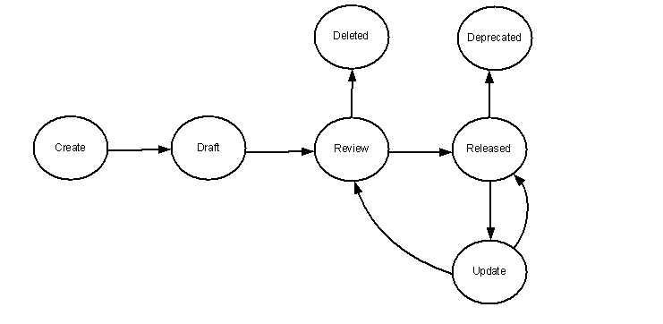
Modeling a Test Design Process
One test case is created for each test objective
Each test case is designed as a combination of modular components called test steps
Test cases are clearly specified so that testers can quickly understand, borrow, and re-use the test cases
Figure 11.6 illustrate the life-cycle model of a test case in the form of a state transition diagram
One can easily implement a database of test cases using the test cases schema shown in Table 11.6
Figure 11.6: State-transition diagram of a test case.

Slide 20
Modeling Test Results
A test suite schema shown in Table 11.7 can be used for testing a particular release
The schema requires a test suite id, a title, an objective and a list of test cases to be managed by the test suite
The idea is to gather a selected number of released test cases and repackage them to form a test suite for a new project
The results of executing those test cases are recorded in a database for gathering and analyzing test metrics
The result of test execution is modeled by using a state-transition diagram as shown in Figure 11.7
The corresponding schema is given in Table 11.8

Slide 21
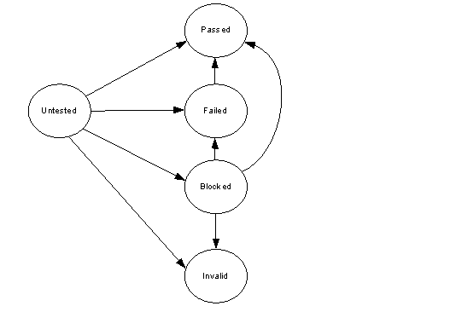
Modeling Test Results
Figure 11.7: State transition diagram of a test case results

Slide 22
Test Design Preparedness Metrics
Metrics are tracked
To know if a test project is progressing according to schedule
Plan the next project more accurately
The following metrics are monitored
Preparation status of test cases (PST)
Average time spent (ATS) in test case design
Number of available test (NAT) cases
Number of planned test (NPT) cases
Coverage of a test suite (CTS)

Slide 23
Test Case Design Effectiveness
The objective of the test design effectiveness metric is to
Measure the defect revealing ability of the test suite
Use the metric to improve the test design process
During system level testing, defects are revealed due to the execution of planned test cases.
A metric commonly used in the industry to measure test case design effectiveness is the Test Case Design Yield (TCDY)
TCE stands for Test Case Escaped
During testing, new defects are found for which no test cases had been planned
For these new defects, new test cases are designed, which is known as Test Case Escaped metric

Slide 24
Thank You!!

